Slide 1
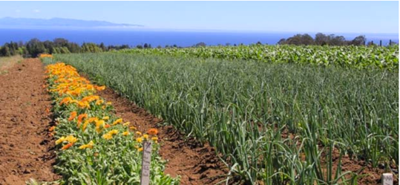


Evaluation 101
The Basics of Program Evaluation for Beginning Farmer and Rancher Programs
August 2019

Slide 2


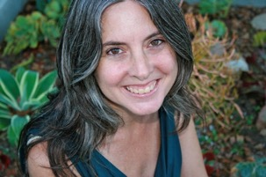
The Team
Presenter: Jan Perez
Contributors: Pam Mavrolas, Elizabeth Combs, Thomas Archibald, Beth Holzman, Amy Bacigalupo.

Slide 3
Agenda
Basic Steps
Welcome & Introduction
Context: GREW project
Webinar purpose & Outcomes
Audience
What is Evaluation
Definition
Examples
Purpose
Orientation
Prepare
Design
Collect and Analyze
Report and Use

Slide 4
Intro:
GREW
Project
Purpose: Support evaluation of beginning farmer training efforts
Activities: Tools, webinars, learning community
Desired Outcomes:
Staff find evaluation accessible, efficient and useful;
Organizations will do more evaluation and improve efforts
More Info: https://casfs.ucsc.edu/education/bfrdp-eet.html

Slide 5
Intro:
Webinar Purpose & Outcomes
Objectives
Provide orientation to the evaluation process
Share resources
Learning Outcomes
Understand basic steps
Feel more interested
Have ideas for next steps

Slide 6
Intro:
Target Audience
Orientation Refresher
Little Experience or Knowledge
Substantial Experience or Knowledge

Slide 7
What is Evaluation?
“. . . program evaluation refers to the thoughtful process of focusing on questions and topics of concern, collecting appropriate information, and then analyzing and interpreting the information for a specific use and purpose”
Planning a Program Evaluation. 1996. University of Wisconsin-Extension. By Ellen Taylor-Power, Sara Steele & Mohammad Douglah. http://learningstore.uwex.edu/assets/pdfs/G3658-1.pdf
“. . . An experiential and systematic inquiry process that fosters learning and program development.” Pam Mavrolas

Slide 8
Purpose of Evaluation
Provide accountability
Provide accountability: To co-workers, board, funders, stakeholders.
Improve
Continually improve program quality: what you do and how you do it.
Allocate
Allocate resources: direct resources toward programs and approaches that are more successful.
Communicate
Communicate your success, challenges.
Create or generate
Create or generate knowledge: Add to a larger body of knowledge about how to affect positive change.
Learn
Learn from putting your plans into action.

Slide 9
Purpose of Evaluation
Learning:
Evaluation as part of what you do

Slide 10
What is Evaluation?
Evaluation Comes in All Sizes
Complex
Simple
Multiple questions
Several stakeholders
Multiple methods
Many uses
One or two questions
Few stakeholders
One method
One use

Slide 11
Basic Steps of Evaluation
Basic Steps
Prepare
Design
Collect and Analyze
Report and Use

Slide 12
1. Prepare
Why are you doing an evaluation?
What is to be evaluated?
Who will be involved in design and implementation?
Who will use the info and how will it be used?
Resources & Capacity

Slide 13
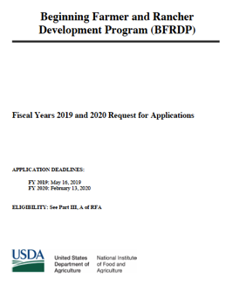
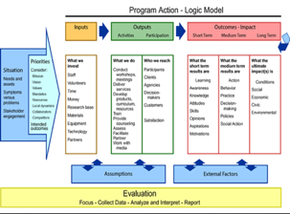
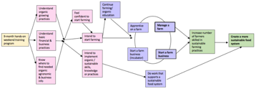
Prepare: Understand the Program
Project Proposal
Logic Model
Theory of Change
From eXtension website. Logic Models: A Tool for Program Planning and Assessment. 2014. http://articles.extension.org/pages/70478/logic-models:-a-tool-for-program-planning-and-assessment

Slide 14


Prepare: How to Approach an Evaluation
Be Curious – Welcome your most curious self
Orient Yourself
Be open to new ways of thinking and acting

Slide 15



Prepare: Main Advice
Keep it simple.
Know how you are going to use it!
Can’t do it all – what is really most important?

Slide 16
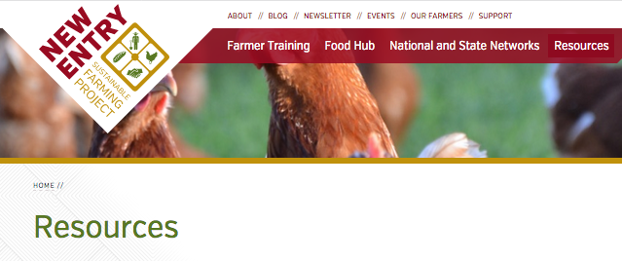
Prepare: Find “How To” Guides
New Entry Resource Library
“How To” Guides
General
Evaluation Plans

Slide 17
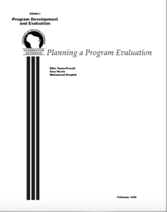
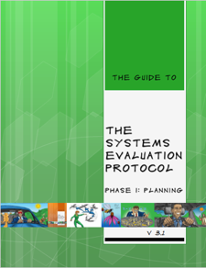
Prepare: Example “How To” Guides
For more basic information on setting up an evaluation (16-page guide) . . .
  learningstore.uwex.edu/Assets/pdfs/G3658-01.pdf
For more in-depth info on setting up an evaluation, creating an evaluation team, identifying resources & capacity, etc.
  https://core.human.cornell.edu/research/systems/protocol/index.cfm

Slide 18
2. Design
Design Your Evaluation Framework or Plan
Identify your questions.
Identify how to measure questions (outcomes & indicators).
Finish the evaluation plan (includes data collection, reporting, resources, etc).

Slide 19
Design: Identify Your Questions
Overarching Evaluation Questions to Frame Your Inquiry
Summative
Formative
What happened as a result of the program
How the program is being implemented, or how it can be improved

Slide 20
Design: Identify Your Questions
Are more starting to farm?
Are they more ready to start?
Summative
Outcome Questions
Are farmers taking actions to make their farms more successful?
Are people better off as a result of our program?
Process Questions
How well is the program designed and implemented?
Is the program effective for all audiences? Is it culturally appropriate?
Formative
Learning Questions
What lessons can be learned from this work?

Slide 21
Design: Identify How to Measure Questions
Outcomes:
Desired changes or results stemming from a program’s activities or efforts.
Indicators:
“A specific, observable, and measurable characteristic or change that shows the progress a program is making toward achieving a specified outcome.” CDC https://www.cdc.gov/eval/guide/glossary/index.htm
Short-term:
Changes in knowledge, attitudes, skills, awareness, or intentions
Medium-term:
Changes in behaviors as the result of learning or immediate impacts from those actions
Long-term:
Changes in social, economic, or environmental conditions – sometimes referred to as impacts

Slide 22

Design: Create a Logic Model/ Theory of Change

Slide 23
Design: Finish the Evaluation Plan
Information Collection
Core evaluation questions to address | Information required | Information sources (and sample) | Data collection and analysis | When to implement | Responsibility
Reporting Requirements
Date | Report type | Writer/s | Audience

Slide 24
Design: Resource Library
New Entry Resource Library
General “How To”
Logic models/ theory of change
Templates
  Evaluation plans
BFR Evaluation Resources
Logic models/theory of change
Evaluation plans

Slide 25

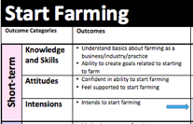
Design: Examples from the Resource Library
Evaluation Plans
Logic Models/ Theory of Change
Outcome/ Indicators
The Netway is an online software tool produced by Cornell University. It provides a template for evaluation plans and provides interactive features to create a logic model and theory of change.
http://core.human.cornell.edu/research/systems/netway.cfm
Coming Soon! An Example Outcome List for beginning farmer and rancher programs is in development as part of the GREW project. Available in Nov 2019.

Slide 26
3. Collect and Analyze
Data collection
2. Collection procedures
3. Analysis

Slide 27
Collect and Analyze: Data Collection & Procedures
Who
How
When
  Data Source
  Methods
  Procedures

Slide 28
Collect and Analyze: Data Collection & Procedures
Who
Data Source
People
Existing Information
Visuals

Slide 29
Collect and Analyze: Data Collection & Procedures
How
Methods
Surveys
Interviews
Focus Groups
Observation

Slide 30
Collect and Analyze: Data Collection & Procedures
When
Procedures
Before the Session or Program
End of Session/Program
Mid-Session
Follow Up

Slide 31
Collect and Analyze: Data Collection
Quantitative
Numbers
How much? How many?
Qualitative
Words, stories, categories
How? Why?

Slide 32

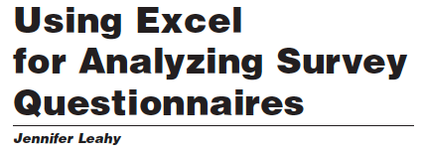

Collect and Analyze: Example “How To” Guides for Analysis
Quantitative Analysis
http://www.racialequitytools.org/resourcefiles/G3658-14.pdf
Qualitative Analysis
https://fyi.extension.wisc.edu/programdevelopment/files/2016/04/Tipsheet20.pdf
All of it
http://www.racialequitytools.org/resourcefiles/PagesSierraGuide12.pdf
Quick Tips
10 Steps to Make Sense of Answers to Open-Ended Questions
We Did It Ourselves
An evaluation Guidebook (Chapter 12)

Slide 33
Collect and Analyze: Example “How To” Guides for Data Collection
New Entry Resource Library
General “How To”
Data collection
Analysis
Templates
BFR Evaluation Resources
Surveys
Assessments
Interview guides

Slide 34
4. Report and Use
Reporting
Using Evaluation Results

Slide 35
Report and Use: Develop Report
Who is your audience?
Granting agencies – look at required reporting format
Other stakeholders – how do they want to receive information
Multiple methods
Written formats, presentations, interactive

Slide 36
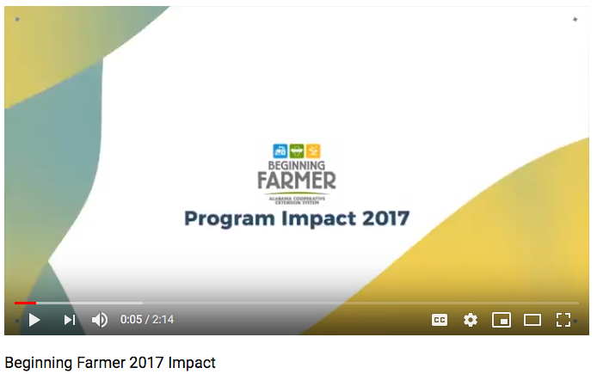
Report and Use: Example
https://www.youtube.com/watch?v=zaONeiRVUps&feature=youtu.be

Slide 37

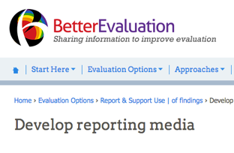
Report and Use:
Example “How To” Guides - Reporting
Basics of Good Evaluation Reporting
https://fyi.extension.wisc.edu/programdevelopment/files/2016/04/Tipsheet14.pdf
Developing Reporting Media
https://www.betterevaluation.org/en/rainbow_framework/report_support_use/develop_reporting_media

Slide 38
Report and Use: Make It Useful
Make Meaning
What does the data say about what is successful?
Identify Changes & Recommendations
What needs to be done to improve the effectiveness of our program?
Plan Next Steps
Who will take actions?
About where there might be shortfalls?
By when?

Slide 39
Report and Use:
Example “How To” Guides - Use
How Can We Use Evaluation Findings to Reflect on and Adjust Our Work?
http://www.racialequitytools.org/resourcefiles/How_Can_We_Use_Evaluation_Findings_To_Reflect_On_And_Adjust_Our_Work.pdf
Better Evaluation: Support Use
https://www.betterevaluation.org/en/rainbow_framework/report_support_use/support_use

Slide 40
What’s Next
Webinars
Learning Communities
How to develop outcomes – November/December
“Evaluation – Stories from the Field: How it Helps” September 18 – 10:30 PT
Tools
Example Outcomes List – November/December 2019
Outcome Pathway Diagrams – November/December 2019
Outcomes - December

Slide 41
Thank you!
Join our list serve to keep in the loop and for resources on Program Evaluation.

Slide 42
Have any feedback?
Please send any comments or suggestions to Jan Perez at jperez@ucsc.edu

